Slide 1

The Paris 2024 Olympic Summer Games (Group 04) Final Group Project Presentation
Submitted By: Deeksha Chauhan, Gayatri Patil, Nikhil Swami, Shweta Shinde
Department of Applied Data Science, San José State University
DATA 230: Data Visualization
Submitted To: Professor Venkata Duvvuri
Submitted On: December 4th, 2024

Slide 2
About the Project
Our project mainly focuses on the Paris Olympics 2024 dataset which includes the comprehensive details about participating nations, sports, athletes, and events. Our main objective was to uncover key trends and insights, such as medal predictions, participation analysis, and the diversity of represented sports, consistently performing countries, players and most dominating sport.
We utilized tools like Python and Power Bi to create visualizations that highlight data patterns. By exploring correlations between factors like participation, disciplines, and medal counts, countries, we aimed to understand the factors influencing Olympic success. We also focused on showcasing gender representation and country-wise participation over time.
The goal behind choosing this dataset was to combine our passion for sports with data visualization to create engaging insights for sports enthusiasts. Our project highlights trends and patterns in the Olympics, helping fans better understand the event and enabling businesses to leverage these insights for growth opportunities in the sports industry.

Slide 3

DATASET DESCRIPTION
The dataset on the Paris 2024 Olympic Summer Games offers various insights into the famous Olympics including different kinds of data for analytics and representation. https://github.com/deeksha7chauhan/Dv-Group_PPT
Key Highlights:
Athletes & Teams: The behavior of the participants and the performance of their respective countries.
Events & Disciplines: Details concerning the sports, events and the calendar of the games.
Medals: Separation of medal tally for the comparison of medal counts in other countries and other events.
Applications for Analysis:
Medal trend and medal distribution by country.
The analyses can include such distinctions as participation by sport or by athlete performance.
Geographical representations of venues and distribution of event.
Sources: Paralympic Summer Games – https://www.kaggle.com/datasets/piterfm/paris-2024-olympic-summer-games/data

Slide 4

Business Problem Objective
The project goal is to offer practical recommendations when analyzing and visualizing trends that characterize the Paris 2024 Olympics, specifically, athlete performance, event popularity, and geographic distributions for those who would like to be prepared accordingly to the event and who could become our target stakeholders, such as broadcasters, sponsors, organizers, and fans.
Problem Statement:
In what way can our past knowledge help us predict future metals and show rivalry trends for Paris 2024?
How could medal-winning patterns of previous Olympic games be helpfully applied to predict outcomes of the 2024 games?
What are the most appealing sports and event to the various groups of fans and globalization aspects?
In what way can venue data best fit into the attendance, broadcasting, and advertising mix?
How can opportunities for sponsors to reach specific consumers by sport or region be defined?
Additional Relevance:
Economic: Ensure that the sponsor gets their worth and achieve high reach during the events that attract high viewership.
Geopolitical: Monitor shifting progression of the sports power balance between countries.
Cultural: Consider regional interests in believing that no two sports are alike.
This analysis should help to increase the Paris 2024 Olympics observed international success level of the sporting, cultural, and business event.

Slide 5
Business Questions
Athlete-Level Performance:
Which countries dominate specific sports consistently?
Economic Impact:
How does medal success correlate with sponsorship revenue?
What is the financial impact of hosting events at certain venues?
Gender & Diversity:
How do male vs. female participation and success trends differ?
How has athlete diversity evolved over time?
Ticketing & Attendance:
Which sports or venues are expected to attract the most audience?
How do ticket pricing and venue accessibility influence attendance?
Predictive & Prescriptive Insights:
Can future event popularity be predicted using historical trends?
What strategies can increase engagement for less popular events?
Technology Integration:
How can technologies like AR/VR enhance audience experience?
What role do social media trends play in shaping event popularity?
Helping Businesses:
How the most consistently performing athletes and countries be found to form partnerships with these brands such as activewear, sporting goods, and supplement brands that demand the same and reach more people at the same time?

Slide 6

EDA
Objective: To learn and deduce the patterns of involvement, medals achievement, and events attraction for Paris 2024 Olympics.
Libraries & Analysis tools Used: Pandas, NumPy, visualization from Matplotlib, Seaborn, and Plotly.
Data Acquisition: Dataset obtained and extracted from Kaggle.
Data Cleaning: Identified the presence of missing observations and treated them according to the columns’ mean/mode. Some entries were merged or excluded from the analysis due to their redundancy or being spam like.
EDA Steps:
Athlete Analysis: Identified distributions of age, gender and country participation.
Country Performance: Displayed medal tally in bar graphs employing the countries aspect of Olympics competition.
Event Popularity: Standing down in order: Identified top events by participation rates.
Geographic Insights: Generated maps with venues and medals illustrated on it. Emphasized on where the venues were and how many people could fit into each of them.
Historical Comparisons: Making a comparison of annual medal winning tendency of top countries through the past Olympic Games.
Key Visualizations: Heatmaps for medal distribution by the country and type of sport. Graphs which demonstrate changes in patterns at certain intervals.
Maps of event places.
Insights: The performance records of dominant countries are apparent in a certain type of sporting disciplines.

Slide 7
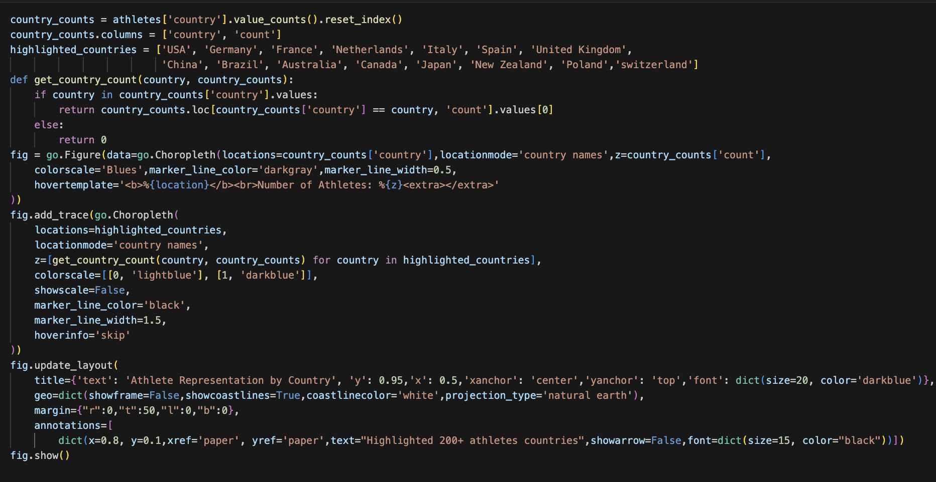
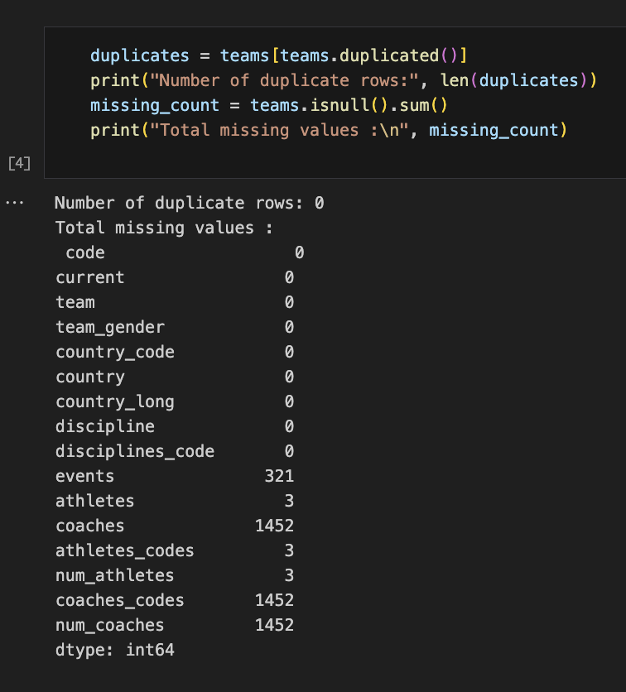
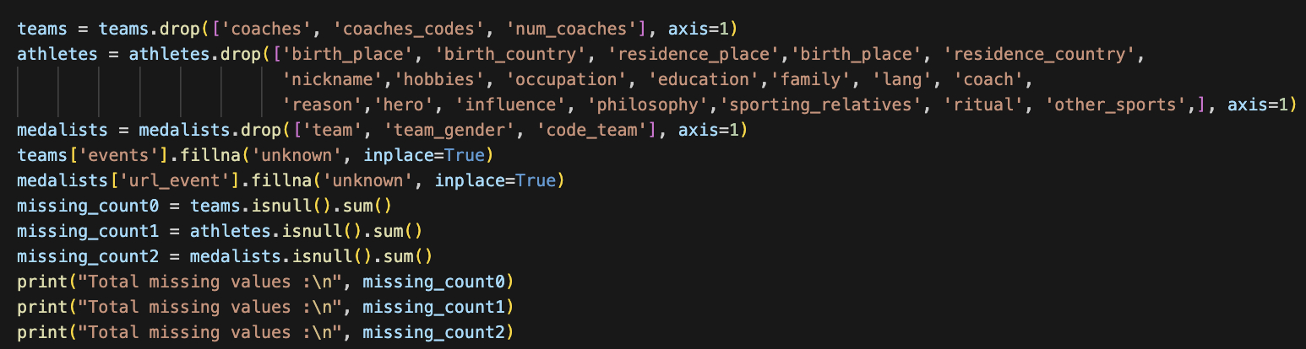
EDA steps:
What are the countries with the most athletes?
Check for missing values
Preprocessing

Slide 8
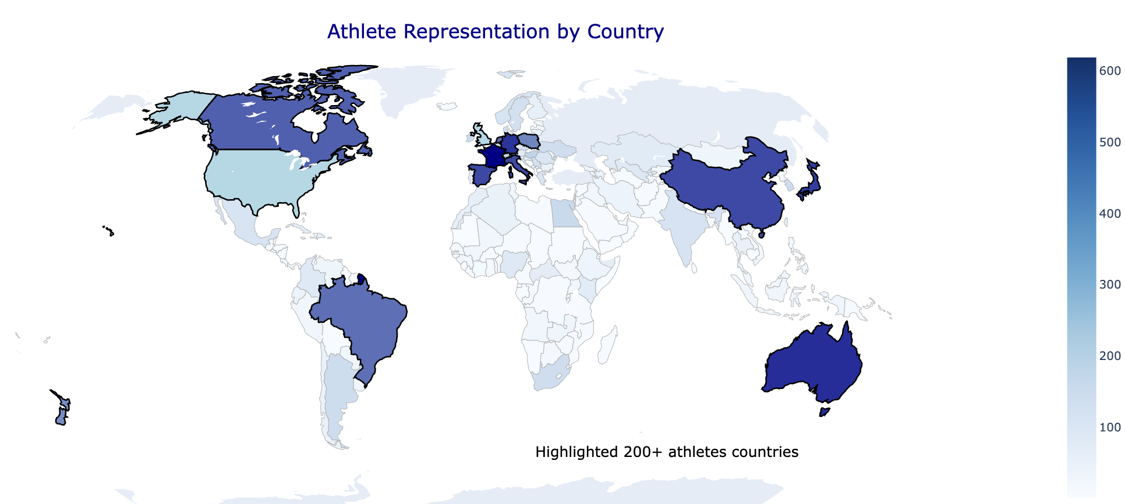

Slide 9


Slide 10
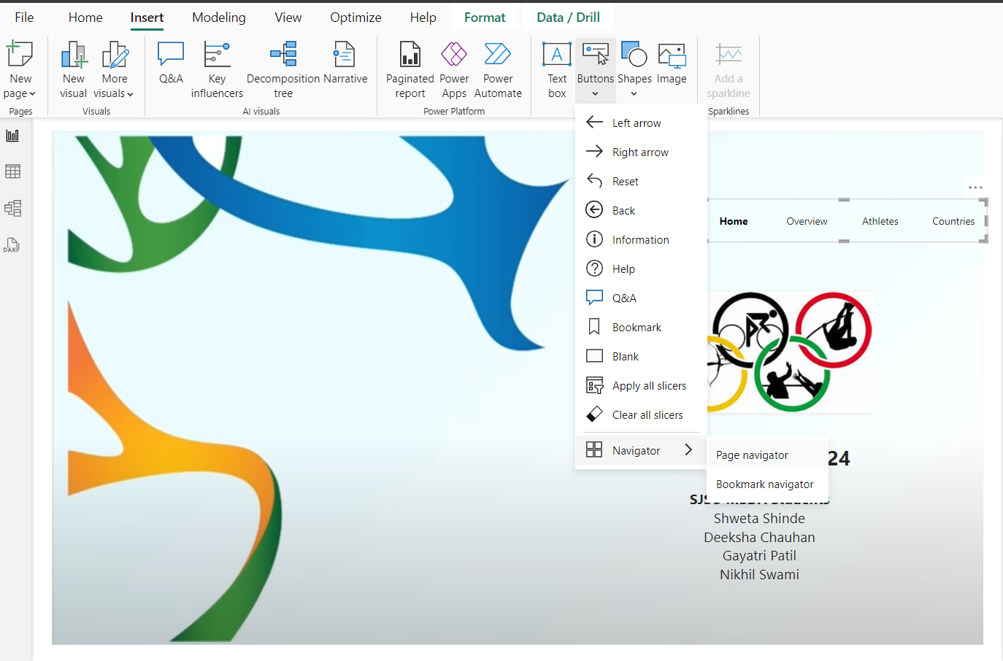
Advance Features

Slide 11
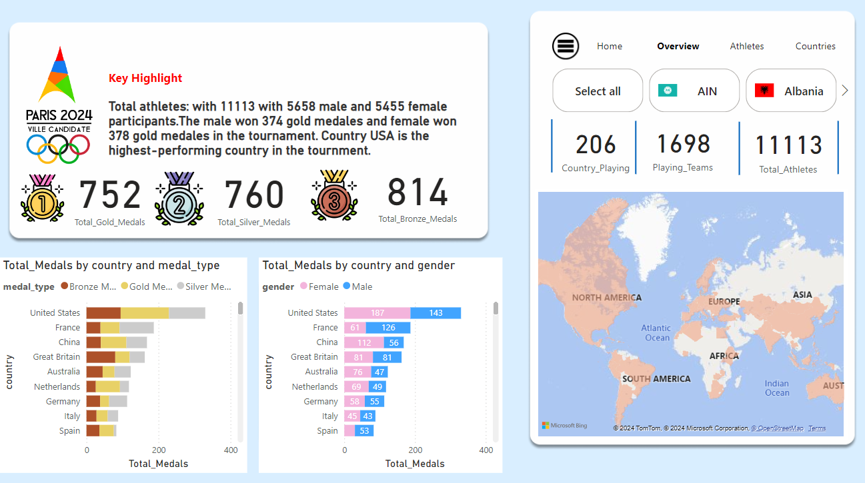

Slide 12
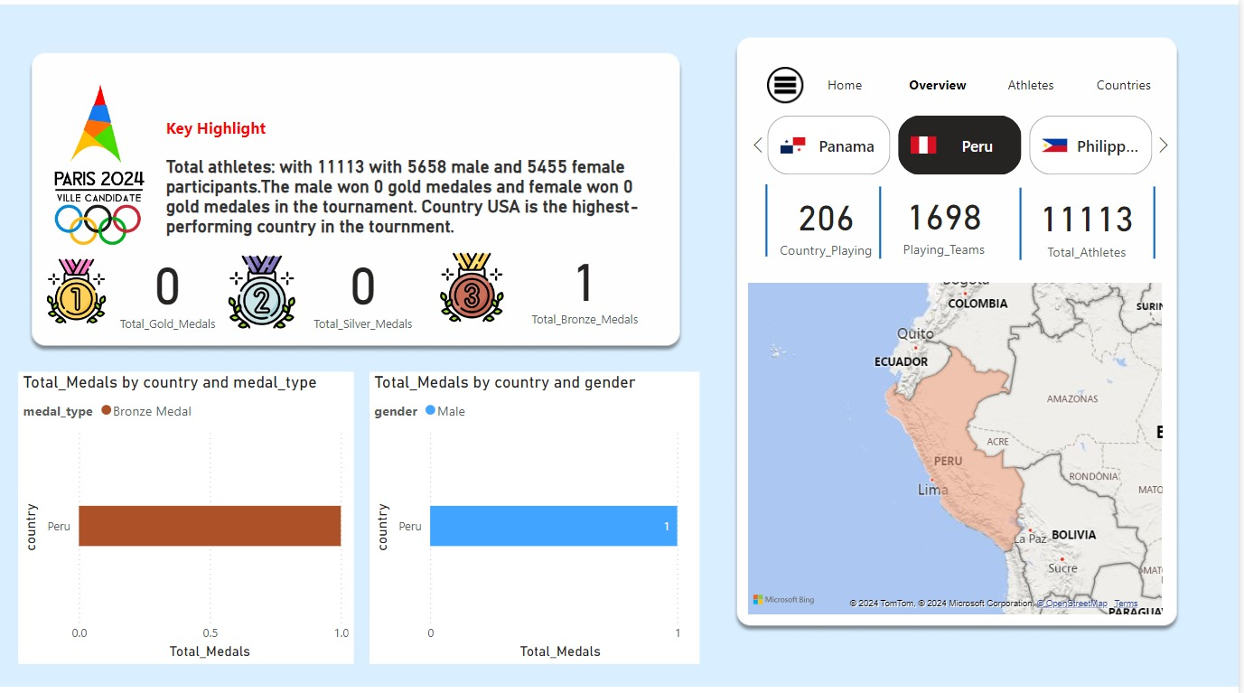

Slide 13
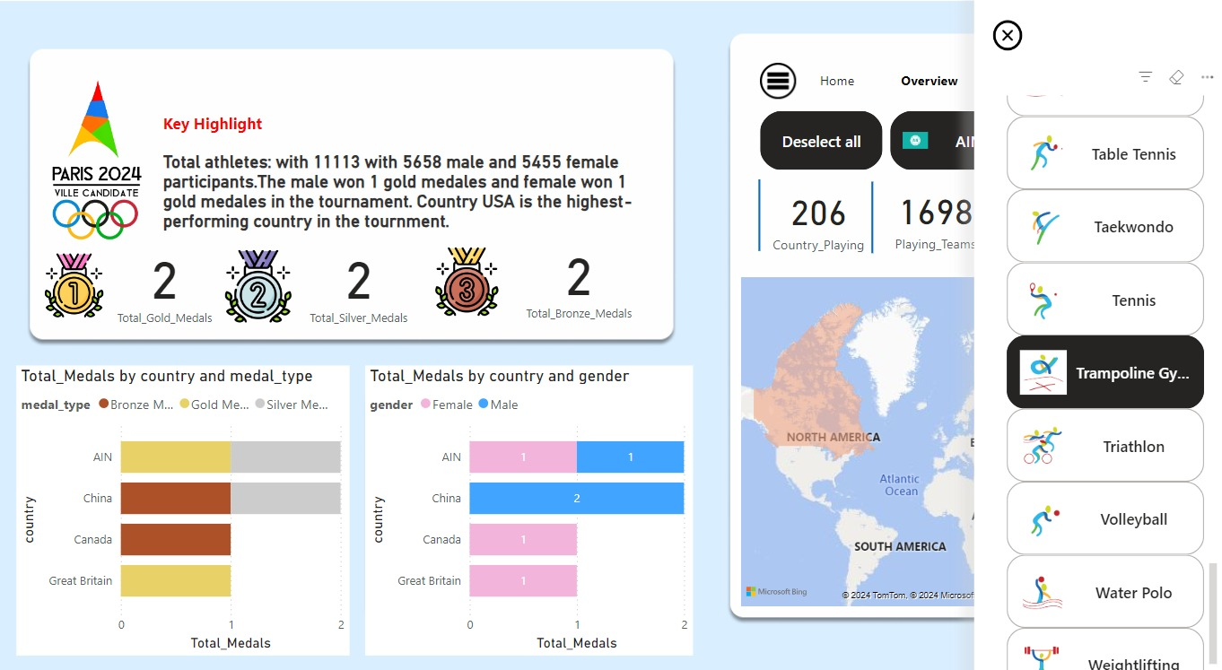

Slide 14
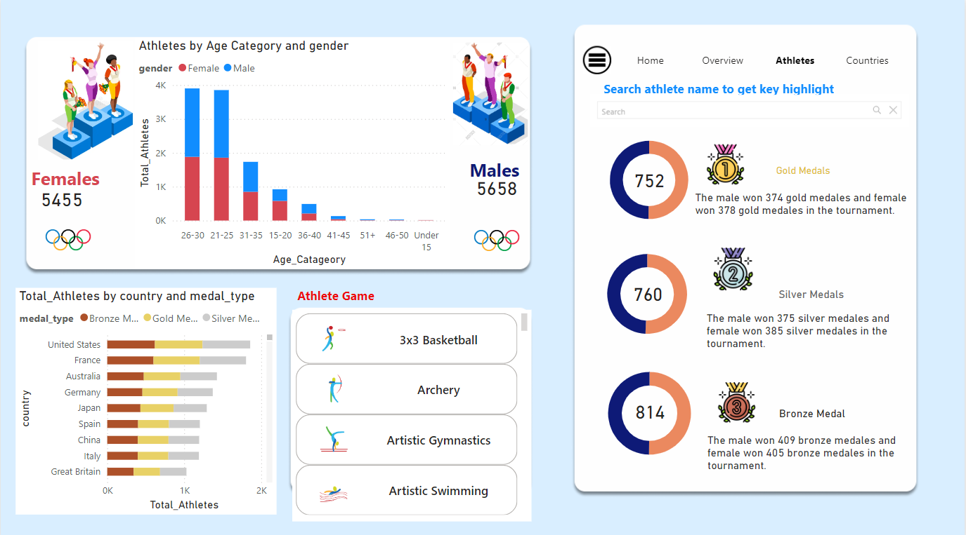

Slide 15
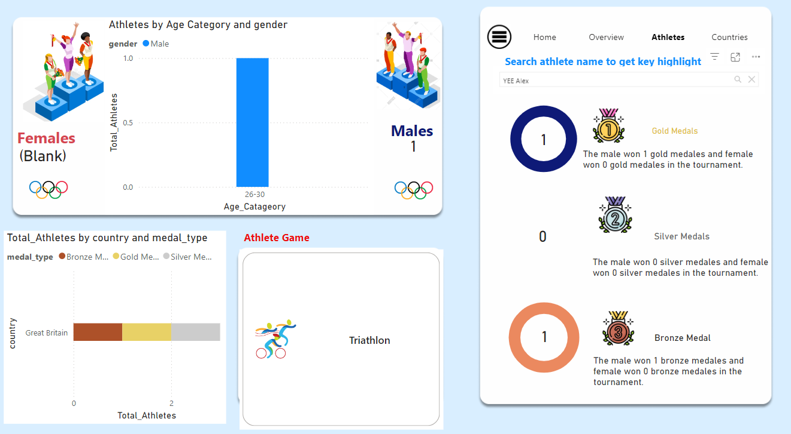

Slide 16
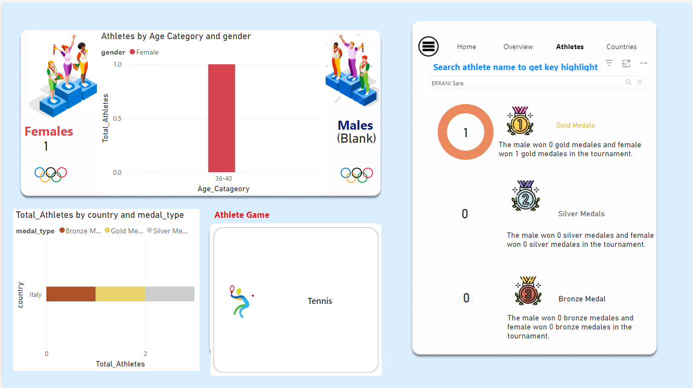

Slide 17
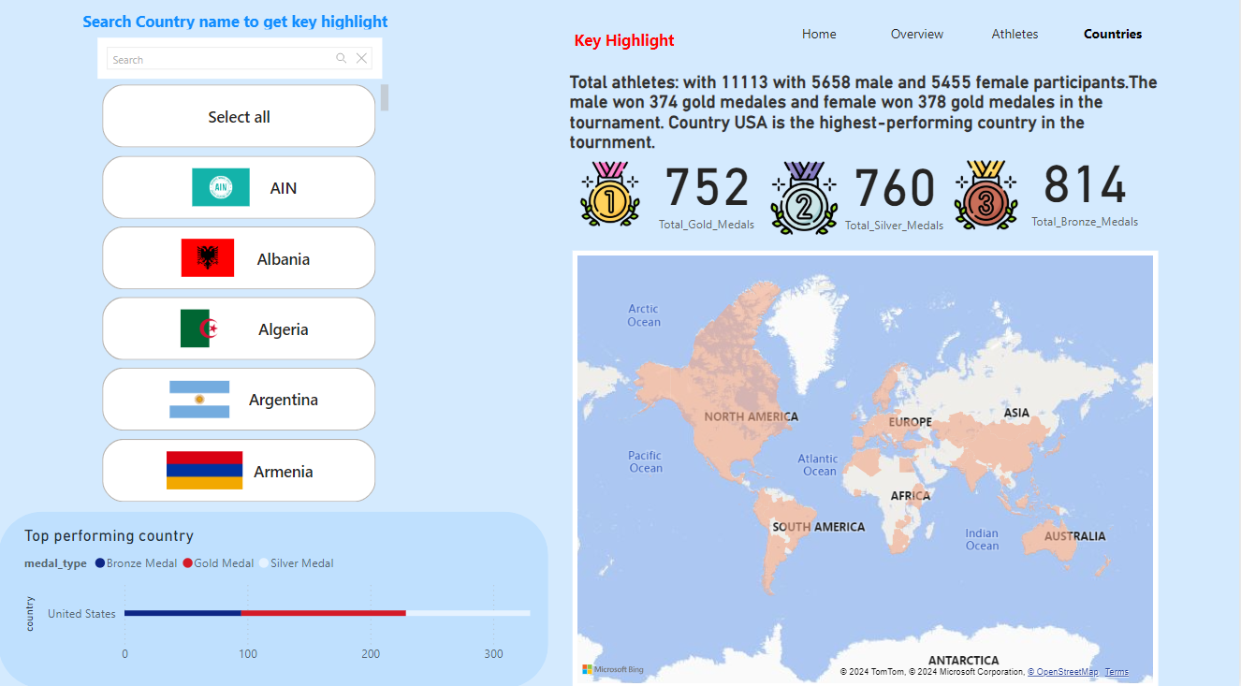

Slide 18
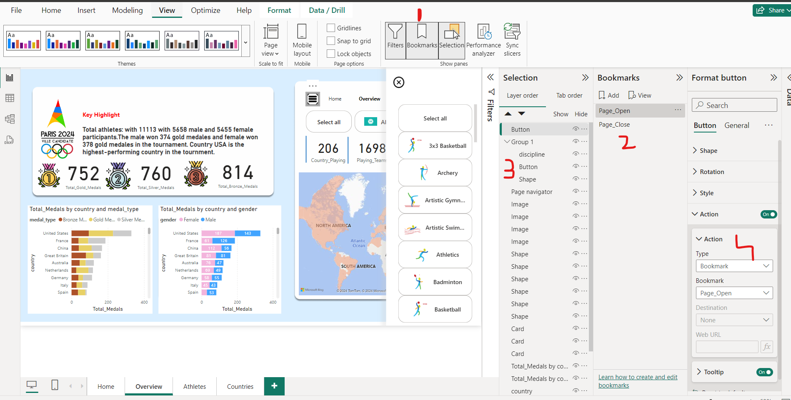

Slide 19
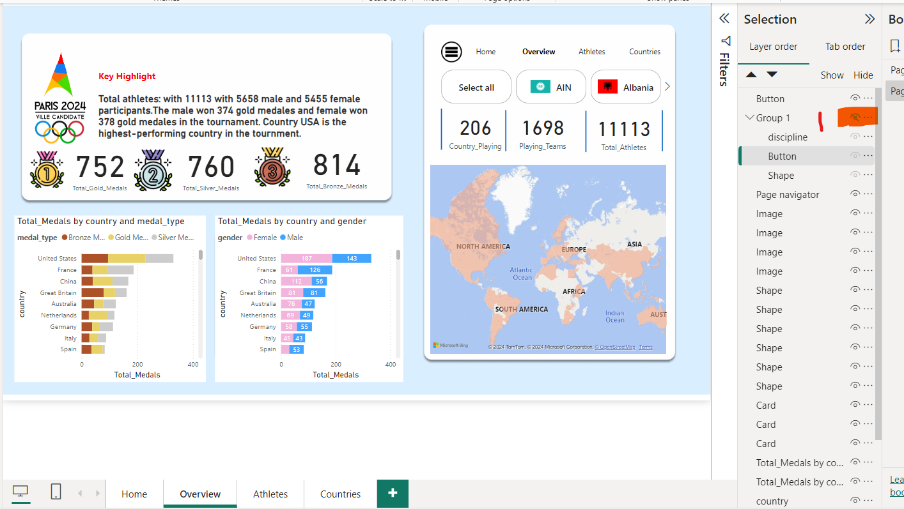

Slide 20
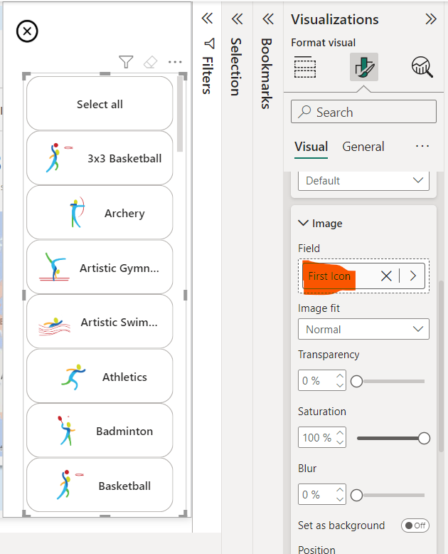
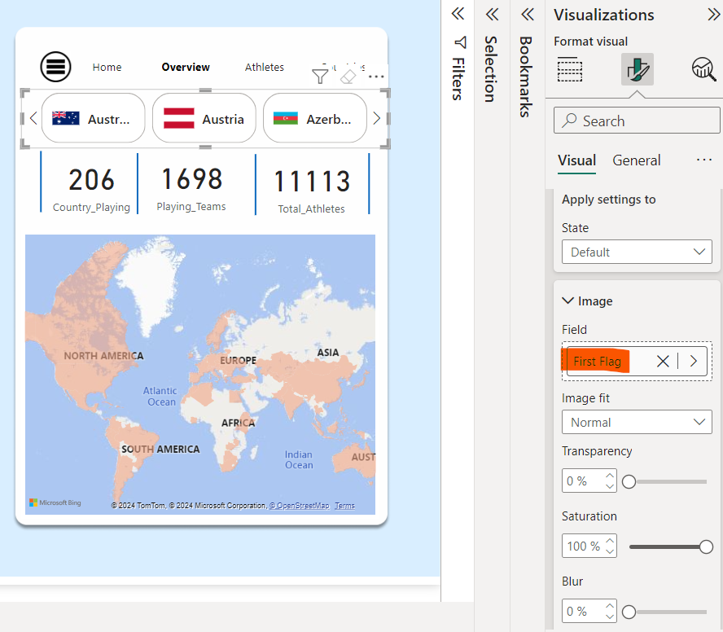

Slide 21
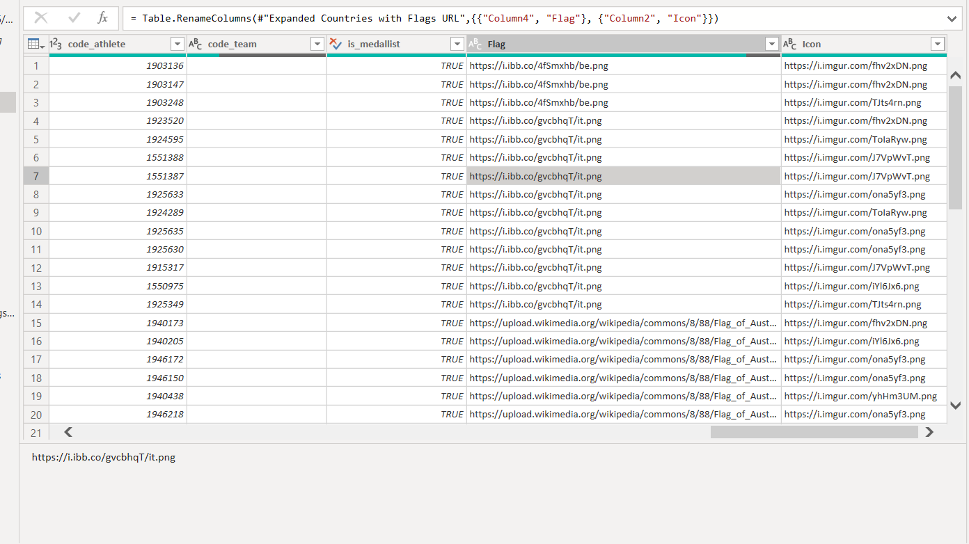

Slide 22
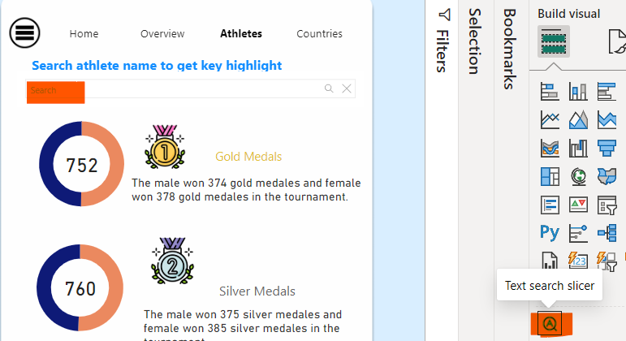

Slide 23
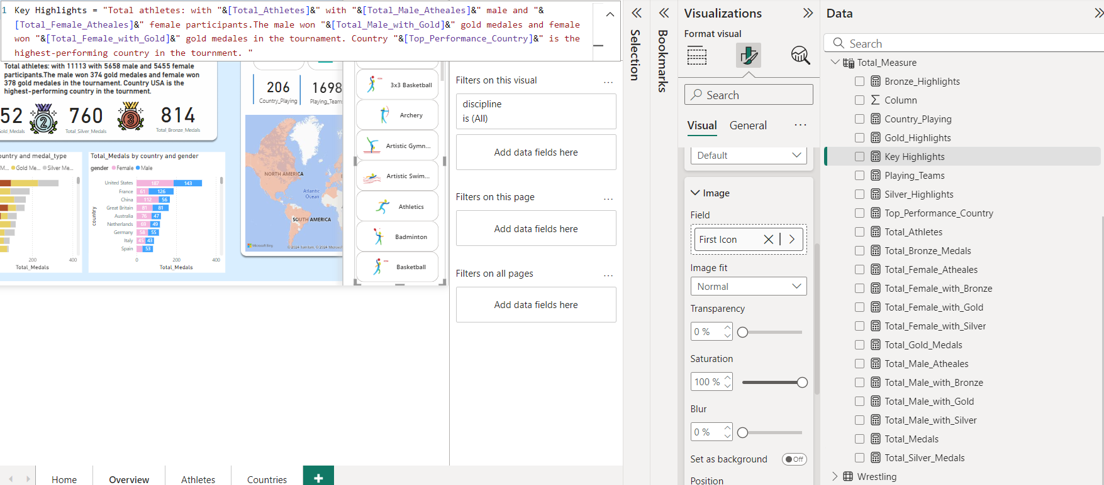

Slide 24
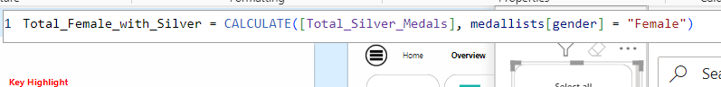
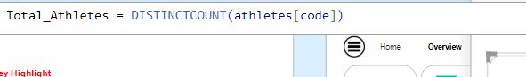
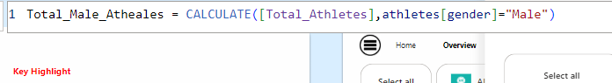

Slide 25
Conclusion
Key Findings:
Distribution of medals is evidence of continuous domination of specific nations, and the analysis of performance and training protocols emerges from it.
The occurrence of events differs worldwide; team events have more fans worldwide than individual events in particular countries.
Thus, the distribution of venues also corresponds with the accessibility of target audiences and, therefore, the maximum coverage.
A breakdown of analysis of gender representation suggests they are improving diversely albeit slowly and the group complains of some disparities concern to some genres of sports.
That is why historical analysis on the relation between GDP and population, on the one hand, and medal number, on the other hand, indicates the impact of resources on the result.
Practical Applications:
For Broadcasters and Sponsors:
It helps to deliver the campaigns and broadcasts more effectively among audiences, focusing on preferences for the regions of their location and according to the time zones.
A few broadly circulate exhibitions and the greatest sportspeople assist in achieving efficient partnership and marketing approaches.
For Organizers:
Resource acquisition is proactive based on research and analysis hence providing efficiency in the use of venues and personnel and infrastructure.
About attendance, event scheduling can be planned well in advance with help of predictive analytics with tendency towards high attendee attendance.
For Future Research:
Trends can inform policy upgrades; for instance, equity for an improvement of athletes’ representation from underrepresented areas.
Combined, this project offers recommendations that help stakeholders make informed decisions, increasing audience interaction, organizational productivity, and overall effectiveness for the Paris 2024 Olympics.

Slide 26

Next Steps
Dataset Enhancements:
Integrate medals obtained, and statistics of participation with the results achieved.
Supplemental from external sources with commonly controlled input variables (e.g., weather, cycles of economic ratios, training expenses, etc.).
Advanced Visualizations:
Employ 3D geospatial map for venue level analysis.
Design dashboards based upon storytelling focused on success and highlights with gender bias analysis.
Predictive Insights:
Forecast event popularity, medal chances, attendance at time zones.
Make positive about future Olympics (2028 and beyond).
Stakeholder-Specific Dashboards:
KPI goals relate to the customizing of specific dashboards for broadcasters, sponsors and event organizers using relevant indicators such as brand awareness.
Economic & Social Impact:
The second one mainly focuses on business growth, tourism and sports development impact on the host nations.
Technological Integration:
Integrate with APIS for live feeds and improve the use of graphics by incorporating AR/VR to the data sets.
Audience Behavior:
Self-serve tickets and use real-time mood tracking from social media.
Collaboration Opportunities:
It is recommended that more cooperation with sports organizations, local government agencies is achieved for better understanding.
Post-Event Analysis:
Reflect on forecasts and suggest better ways of approaching other such events.
Automation & Scalability:
Invite data processing and expand the project to other international sporting events.

